Slide 1
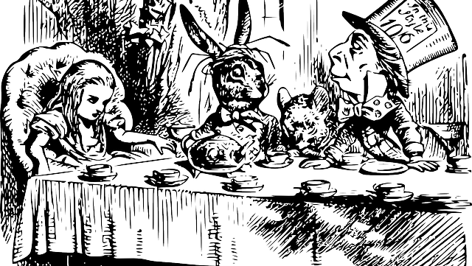
MAD Tea
Inviting our learners into the conversation…

Slide 2
What is Mad tea?
Liberating Structure - provides an opportunity for all participants to engage
Low-risk structure
all students to participate
“Borrow” others ideas
Create and broaden our shared understanding

Slide 3
Mad tea etiquette
Stay curious, dig deep, have fun
Honour your first thought
USING CHAT – finish each of the open sentences with a short phrase
Hit the return button when we tell you and we’ll see a waterfall of responses

Slide 4
Mad Tea
I will pose an open-ended statement…you type your answer into the chat bar BUT YOU DO NOT HIT ENTER
When I ask, we all hit enter at the same time

Slide 5
Type in the chat…
DO NOT HIT ENTER!
WAIT!
I’M SERIOUS…WAIT ☺
Let’s try it out
If a movie was made of my life, the actor who would play me is…

Slide 6
Once familiarity and community has been established…
Invite learners to go back and acknowledge each other. They can react, respond or borrow an idea
Seriously…we share and build our knowledge ☺

